Slide 1
UML diagramına bakarak kod yazma ve kodu belli toollar ile UML'e dönüştürme
Labarotary 2

Slide 2
Convertıng UML to Java code
First we create a class diagram for our project.
In this example we preare an UML diagram via www.draw.io website.
You can use any other resources as well.

Slide 3
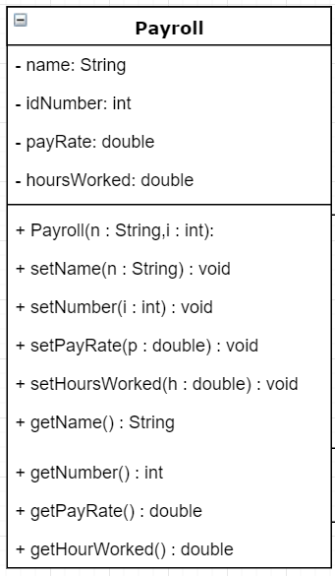
Example class dıagram
Payroll Class:
Has four private attributes,
Has one class constractor,
Has necessary setters and getters.

Slide 4
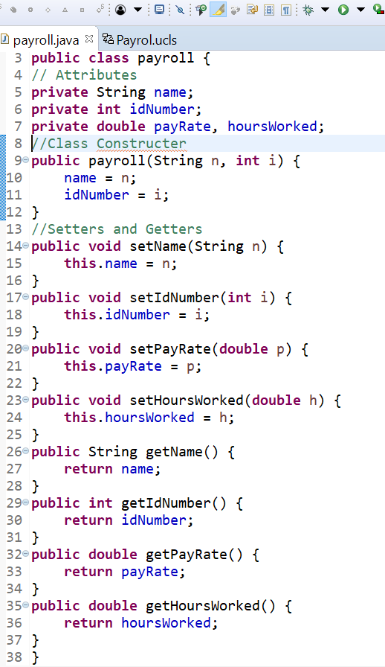
Convertıng case dıagram to java code
As we seen on the previous labaratory our class diagram consists of name, attributes, and methods parts.
For Payroll class we need to create a Java class .
At the end, our code should look similar to this.

Slide 5
Usıng UML plugıns
There are many free UML drawing extentions on Eclipse market.
You can choose any one.
In this lab. we will use «Objectaid» plugin.

Slide 6
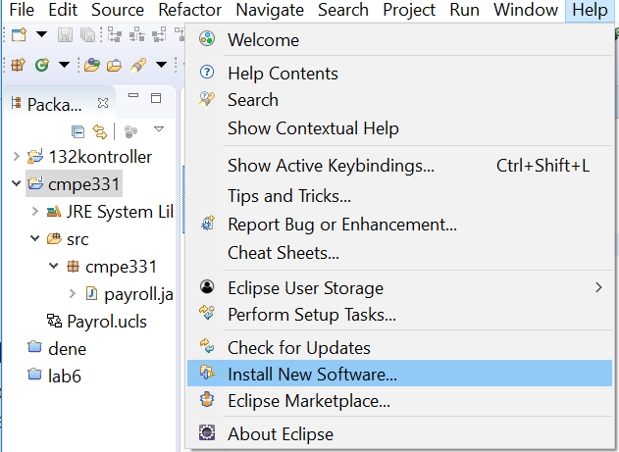
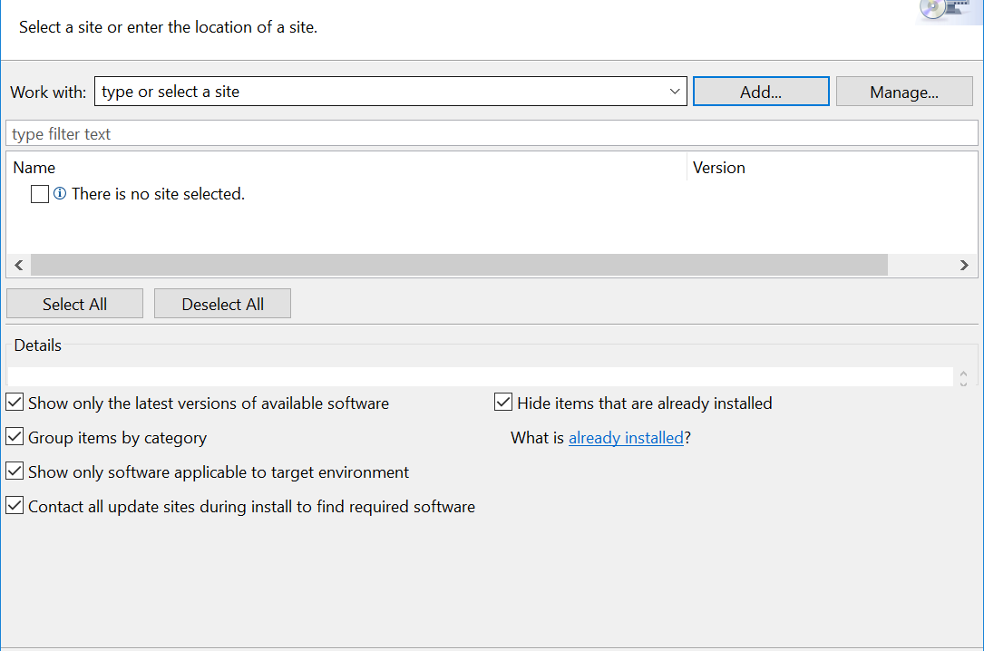
How to get uml Plugın
Open your Eclipse
Choose Help-> Install New Software
Add Repository
A window will pop. Copy the link
http://www.objectaid.com/update/current
If your Eclipse has marketplace plugin just drag and drop
https://marketplace.eclipse.org/search/site/objectaid

Slide 7
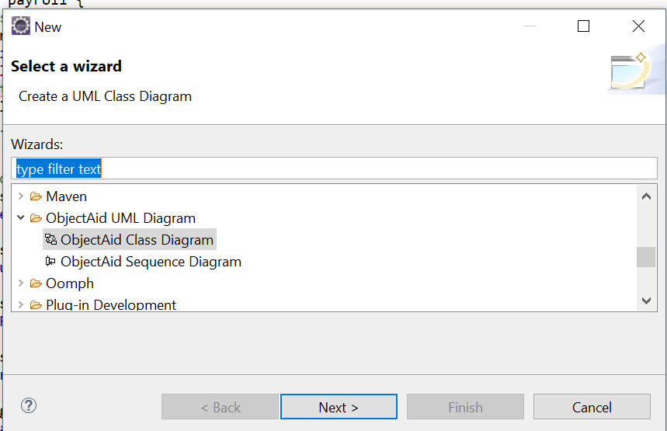
Convertıng java code to uml class dıagrams
Open Eclipse
Create a new ObjectAid class at your existing project.
You can continue to use our payroll project
New -> Other -> Choose Objectaid UML Design
In this example we will use class diagrams.

Slide 8
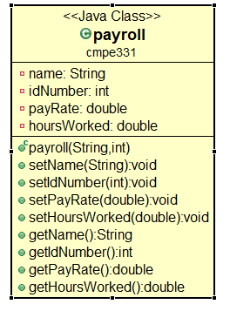
Convertıng java code to uml class dıagrams(Cont.)
Open your src folder.
Drag and drop payroll.java into the payroll.ucls file
It will automatically create a class diaram for us.

Slide 9
homework
First: Please do not forget to upload your lab works!
You can find your worksheet on learn.bilgi.edu.tr
You need to upload the java code and UML Class Diagram for this work.
No groups!!
Please add your student info to your code as comments.
Good luck!

